Slide 1
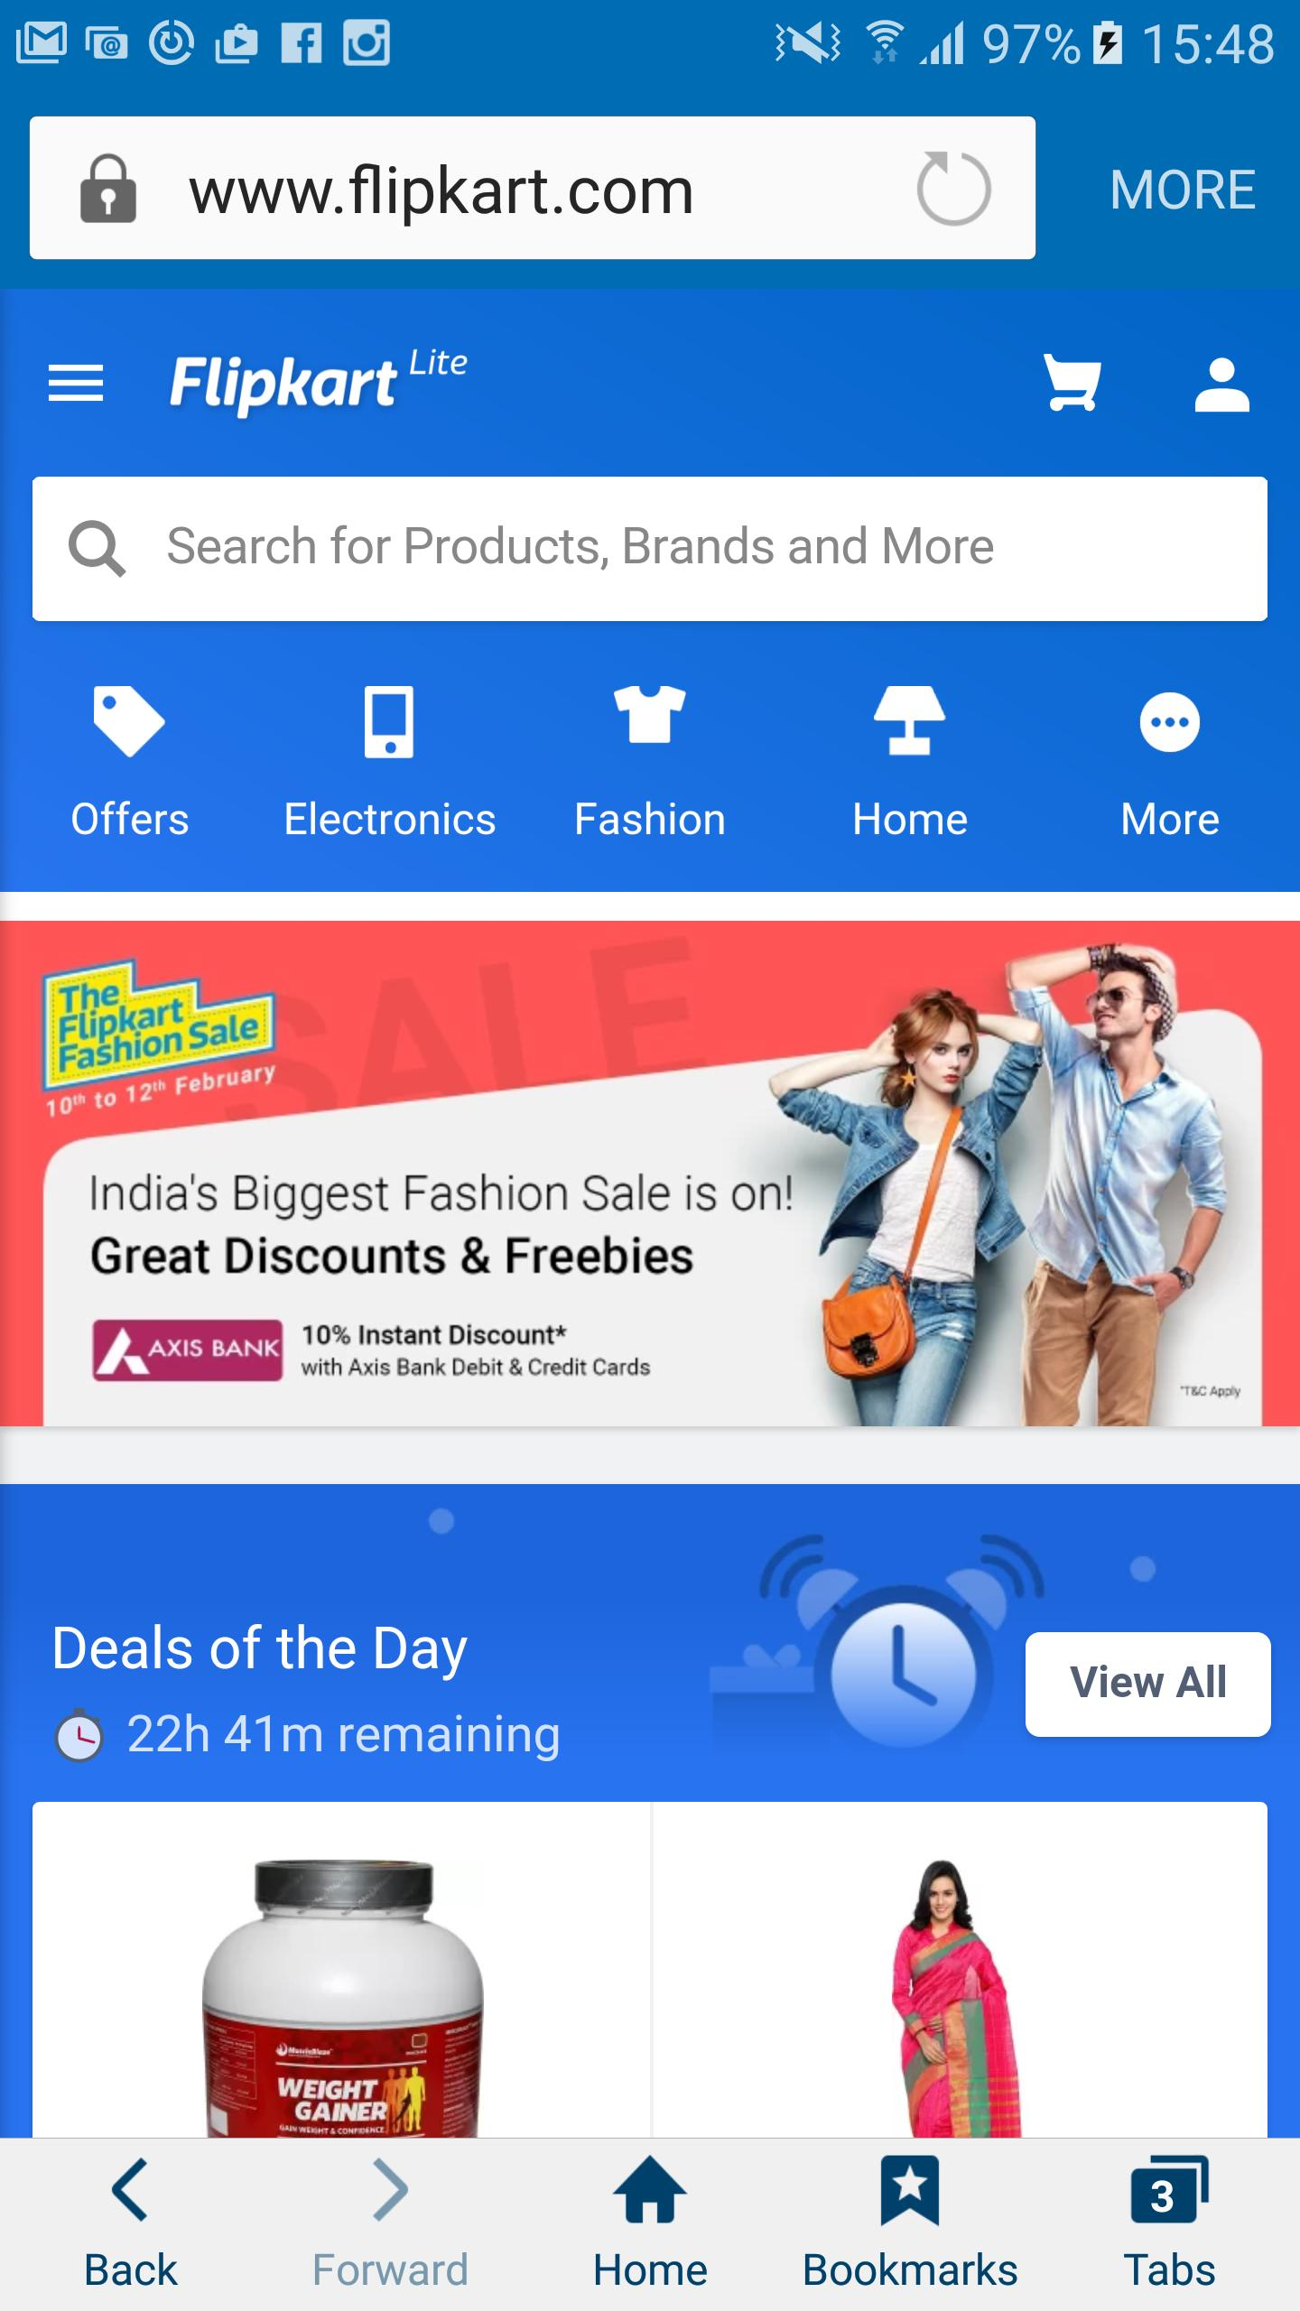

Flipkart Mobile Phone Sales & Reviews
San Jose State University, Department of Data Analytics
DATA 230: DATA VISUALIZATION
Professor: H. Andrew Bond
December 6, 2022
From
Hruthik Vinnakota
SJSU Student ID: 016047824

Slide 2

Introduction
1
Concept brief
2
Data Source
3
Calculated measures
4
Demo
5
Charts & Story
6
Conclusion

Slide 3
Concept brief
An online retail service that allows customers to buy their products on the platform called ‘Flipkart.com’.
Various mobile phone sales of several brands traded on the Flipkart e-commerce website.
A complete visualization of data that consists of a wide range of mobile brands, models, storage, stock availability, certain specifications including color,
internal memory, ram, its highlights, selling and original prices, 1 - 5 stars rating, and reviews.
The result consists of various tableau sheets and dashboards which portray distinct visualization charts and graphs that simplify for end users to select the mobile phone of their choice from the Flipkart platform.

Slide 4
Data Source
Domain: Flipkart mobile sales data
Data Source: Downloaded from Kaggle datasets.
Flipkart smartphones:
https://www.kaggle.com/datasets/jithinanievarghese/flipkart-smartphones-dataset

Slide 5
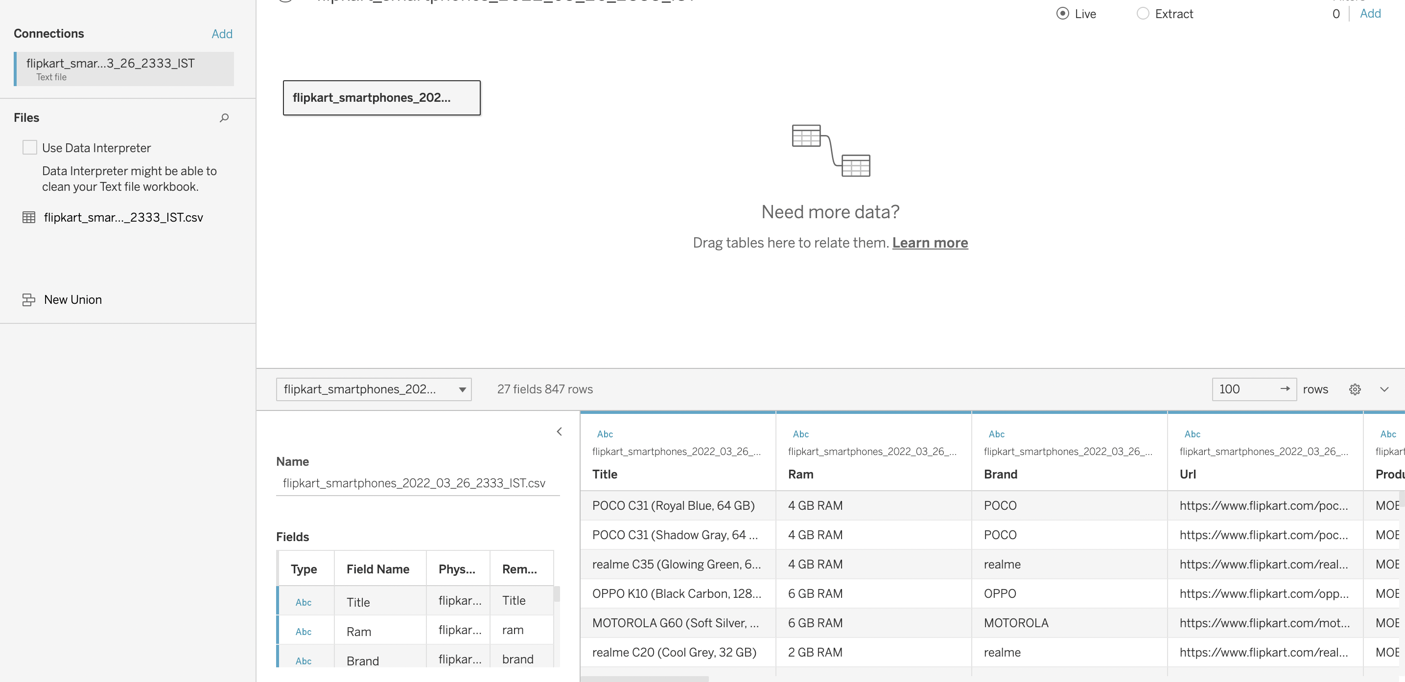
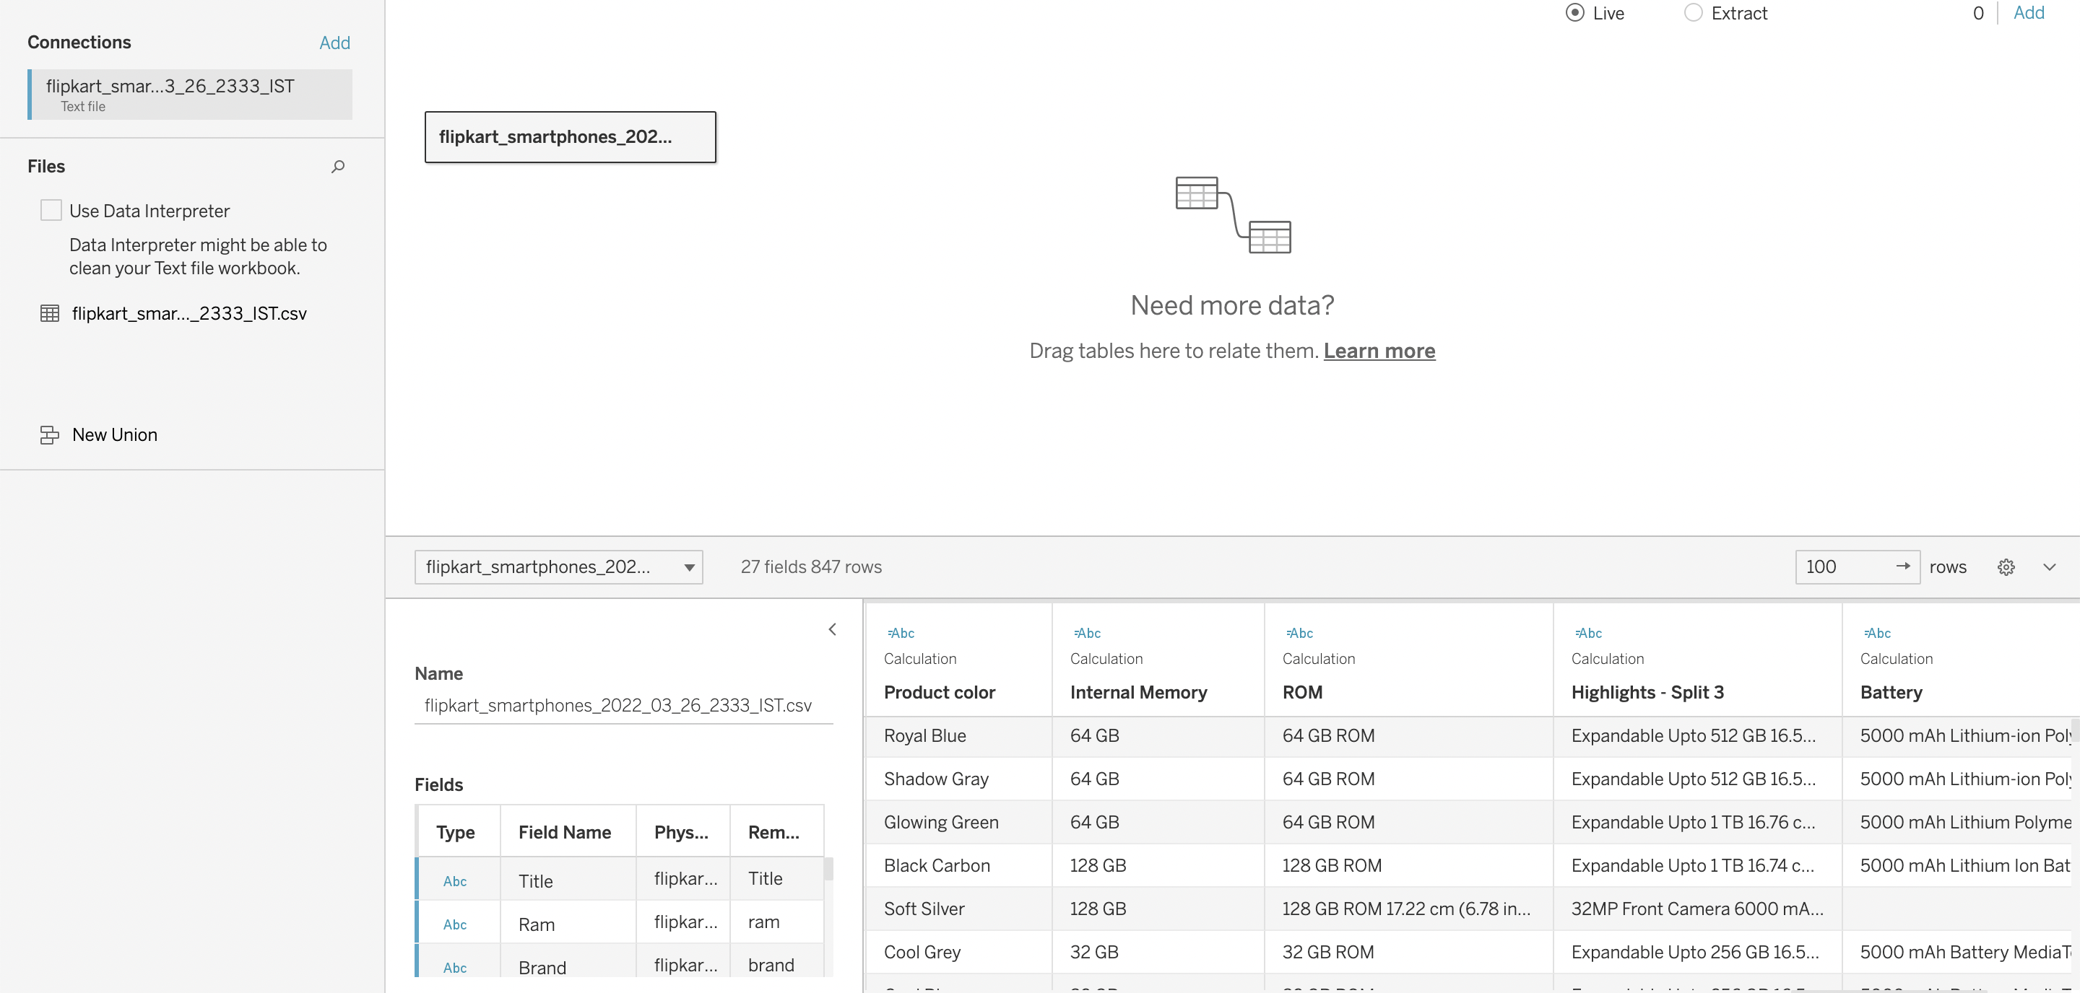
Calculated measures
Visualization tools: Tableau
Data Cleaning Strategies if any: Split the “Title” column into multiple columns (internal memory, product model, product color). Removed additional spaces for few columns.

Slide 6

#Visualization_Demo
#DEMO

Slide 7
Conclusion
I can conclude that in this project I have created several dashboards, stories,
and visualization. On the Flipkart e-commerce platform, customers can scrutinize various mobile stock availability, selling prices, original prices, ratings, and
specifications.
Reviews count and average ratings are compared and proclaimed the original price and Flipkart’s selling price, and the user average rating from one to five stars are stated for various mobile brands. Eventually, by viewing these charts it is accessible to end users to opt for the mobile of their choice.

Slide 8


